Slide 1
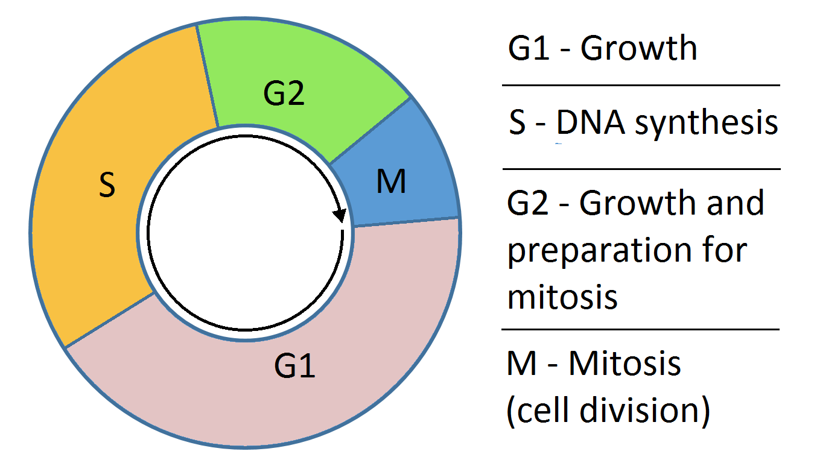
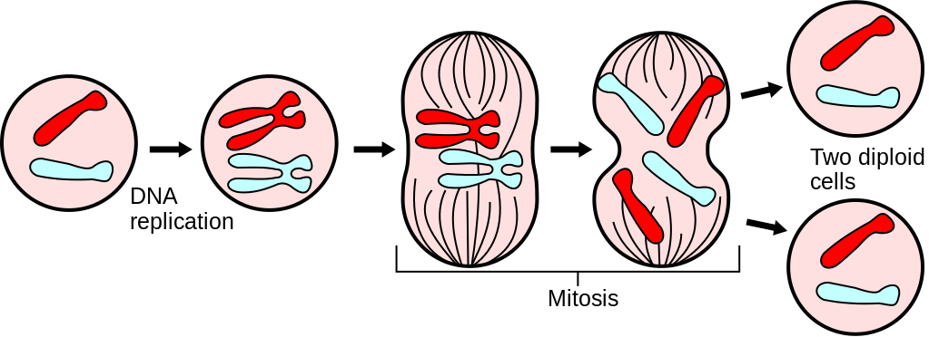
A Mathematical Description of Regulation of the G1-S Transition of the Mammalian Cell Cycle
Presented by: Mike Huang, Chih-Chi Liu

Slide 2
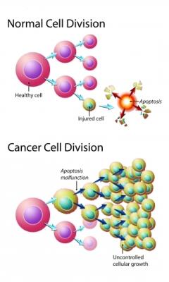
Background
Cell cycle contains many checkpoints that must be met to ensure all of the requisite processes occurs before cell division continues.
Errors result in uncontrolled growth - cancer

Slide 3
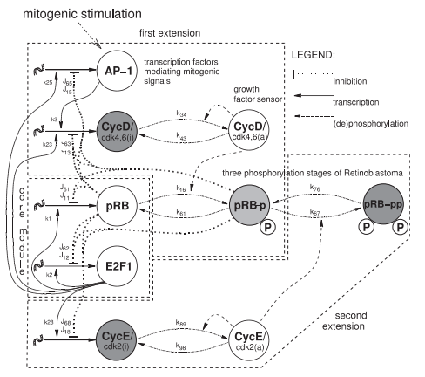
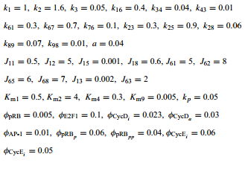
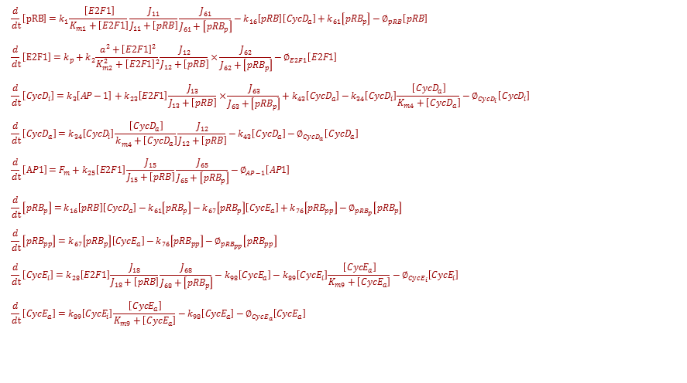
Schematics of the Model
$$\frac{d}{dt}\left[pRB\right]=k_{1}\frac{\left[E2F1\right]}{K_{m1}+\left[E2F1\right]}\frac{J_{11}}{J_{11}+\left[pRB\right]}\frac{J_{61}}{J_{61}+\left[{pRB}_{p}\right]}−k_{16}\left[pRB\right]\left[{CycD}_{a}\right]+k_{61}\left[{pRB}_{p}\right]−∅_{pRB}\left[pRB\right]$$
$$\frac{d}{dt}\left[E2F1\right]=k_{p}+k_{2}\frac{{a^{2}+\left[E2F1\right]}^{2}}{K_{m2}^{2}+{\left[E2F1\right]}^{2}}\frac{J_{12}}{J_{12}+\left[pRB\right]}×\frac{J_{62}}{J_{62}+\left[{pRB}_{p}\right]}−∅_{E2F1}\left[E2F1\right]$$
$$\frac{d}{dt}\left[{CycD}_{i}\right]=k_{3}\left[AP−1\right]+k_{23}\left[E2F1\right]\frac{J_{13}}{J_{13}+\left[pRB\right]}×\frac{J_{63}}{J_{63}+\left[{pRB}_{p}\right]}+k_{43}\left[{CycD}_{a}\right]−k_{34}\left[{CycD}_{i}\right]\frac{\left[{CycD}_{a}\right]}{K_{m4}+\left[{CycD}_{a}\right]}−∅_{{CycD}_{i}}\left[{CycD}_{i}\right]$$
$$\frac{d}{dt}\left[{CycD}_{a}\right]=k_{34}\left[{CycD}_{i}\right]\frac{\left[{CycD}_{a}\right]}{k_{m4}^{}+\left[{CycD}_{a}\right]}\frac{J_{12}}{J_{12}+\left[pRB\right]}−k_{43}\left[{CycD}_{a}\right]−∅_{{CycD}_{a}}\left[{CycD}_{a}\right]$$
$$\frac{d}{dt}\left[AP1\right]=F_{m}+k_{25}\left[E2F1\right]\frac{J_{15}}{J_{15}+\left[pRB\right]}\frac{J_{65}}{J_{65}+\left[{pRB}_{p}\right]}−∅_{AP−1}\left[AP1\right]$$
$$\frac{d}{dt}\left[{pRB}_{p}\right]=k_{16}\left[pRB\right]\left[{CycD}_{a}\right]−k_{61}\left[{pRB}_{p}\right]−k_{67}\left[{pRB}_{p}\right]\left[{CycE}_{a}\right]+k_{76}\left[{pRB}_{pp}\right]−∅_{{pRB}_{p}}\left[{pRB}_{p}\right]$$
$$\frac{d}{dt}\left[{pRB}_{pp}\right]=k_{67}\left[{pRB}_{p}\right]\left[{CycE}_{a}\right]−k_{76}\left[{pRB}_{pp}\right]−∅_{{pRB}_{pp}}\left[{pRB}_{pp}\right]$$
$$\frac{d}{dt}\left[{CycE}_{i}\right]=k_{28}\left[E2F1\right]\frac{J_{18}}{J_{18}+\left[pRB\right]}\frac{J_{68}}{J_{68}+\left[{pRB}_{p}\right]}−k_{98}\left[{CycE}_{a}\right]−k_{89}\left[{CycE}_{i}\right]\frac{\left[{CycE}_{a}\right]}{K_{m9}+\left[{CycE}_{a}\right]}−∅_{{CycE}_{i}}\left[{CycE}_{i}\right]$$
$$\frac{d}{dt}\left[{CycE}_{a}\right]=k_{89}\left[{CycE}_{i}\right]\frac{\left[{CycE}_{a}\right]}{K_{m9}+\left[{CycE}_{a}\right]}−k_{98}\left[{CycE}_{a}\right]−∅_{{CycE}_{a}}\left[{CycE}_{a}\right]$$
3

Slide 4
Specific Aims of the Study
Study the significance of cyclin D and cyclin E by overexpressed them in the G1/S transition
Perform the bifurcation analysis
Can the framework make predictions that can lead to interventions to tumorigenesis?
4

Slide 5
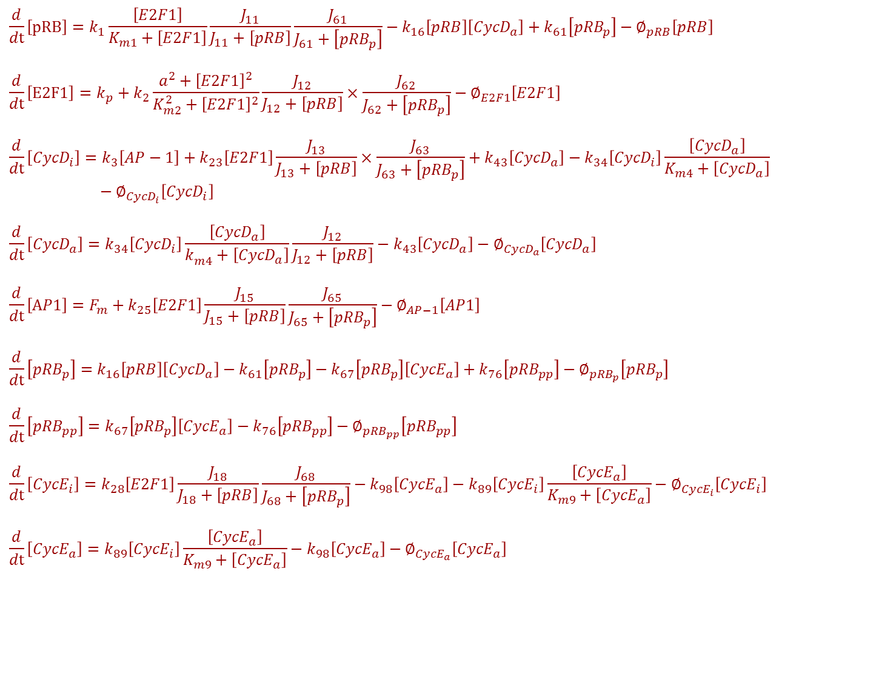
$$\frac{d}{dt}\left[pRB\right]=k_{1}\frac{\left[E2F1\right]}{K_{m1}+\left[E2F1\right]}\frac{J_{11}}{J_{11}+\left[pRB\right]}\frac{J_{61}}{J_{61}+\left[{pRB}_{p}\right]}−k_{16}\left[pRB\right]\left[{CycD}_{a}\right]+k_{61}\left[{pRB}_{p}\right]−∅_{pRB}\left[pRB\right]$$
$$\frac{d}{dt}\left[E2F1\right]=k_{p}+k_{2}\frac{{a^{2}+\left[E2F1\right]}^{2}}{K_{m2}^{2}+{\left[E2F1\right]}^{2}}\frac{J_{12}}{J_{12}+\left[pRB\right]}×\frac{J_{62}}{J_{62}+\left[{pRB}_{p}\right]}−∅_{E2F1}\left[E2F1\right]$$
$$\frac{d}{dt}\left[{CycD}_{i}\right]=k_{3}\left[AP−1\right]+k_{23}\left[E2F1\right]\frac{J_{13}}{J_{13}+\left[pRB\right]}×\frac{J_{63}}{J_{63}+\left[{pRB}_{p}\right]}+k_{43}\left[{CycD}_{a}\right]−k_{34}\left[{CycD}_{i}\right]\frac{\left[{CycD}_{a}\right]}{K_{m4}+\left[{CycD}_{a}\right]}−∅_{{CycD}_{i}}\left[{CycD}_{i}\right]$$
$$\frac{d}{dt}\left[{CycD}_{a}\right]=k_{34}\left[{CycD}_{i}\right]\frac{\left[{CycD}_{a}\right]}{k_{m4}^{}+\left[{CycD}_{a}\right]}\frac{J_{12}}{J_{12}+\left[pRB\right]}−k_{43}\left[{CycD}_{a}\right]−∅_{{CycD}_{a}}\left[{CycD}_{a}\right]$$
$$\frac{d}{dt}\left[AP1\right]=F_{m}+k_{25}\left[E2F1\right]\frac{J_{15}}{J_{15}+\left[pRB\right]}\frac{J_{65}}{J_{65}+\left[{pRB}_{p}\right]}−∅_{AP−1}\left[AP1\right]$$
$$\frac{d}{dt}\left[{pRB}_{p}\right]=k_{16}\left[pRB\right]\left[{CycD}_{a}\right]−k_{61}\left[{pRB}_{p}\right]−k_{67}\left[{pRB}_{p}\right]\left[{CycE}_{a}\right]+k_{76}\left[{pRB}_{pp}\right]−∅_{{pRB}_{p}}\left[{pRB}_{p}\right]$$
$$\frac{d}{dt}\left[{pRB}_{pp}\right]=k_{67}\left[{pRB}_{p}\right]\left[{CycE}_{a}\right]−k_{76}\left[{pRB}_{pp}\right]−∅_{{pRB}_{pp}}\left[{pRB}_{pp}\right]$$
$$\frac{d}{dt}\left[{CycE}_{i}\right]=k_{28}\left[E2F1\right]\frac{J_{18}}{J_{18}+\left[pRB\right]}\frac{J_{68}}{J_{68}+\left[{pRB}_{p}\right]}−k_{98}\left[{CycE}_{a}\right]−k_{89}\left[{CycE}_{i}\right]\frac{\left[{CycE}_{a}\right]}{K_{m9}+\left[{CycE}_{a}\right]}−∅_{{CycE}_{i}}\left[{CycE}_{i}\right]$$
$$\frac{d}{dt}\left[{CycE}_{a}\right]=k_{89}\left[{CycE}_{i}\right]\frac{\left[{CycE}_{a}\right]}{K_{m9}+\left[{CycE}_{a}\right]}−k_{98}\left[{CycE}_{a}\right]−∅_{{CycE}_{a}}\left[{CycE}_{a}\right]$$

Slide 6
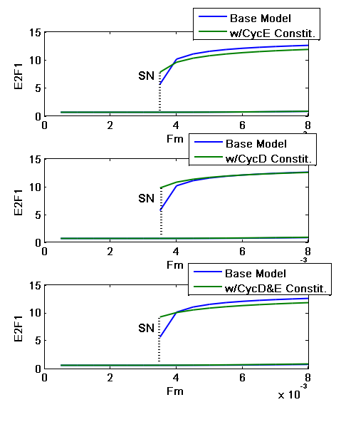
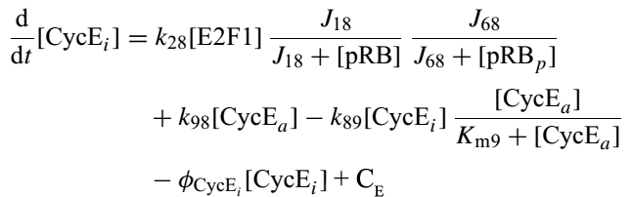
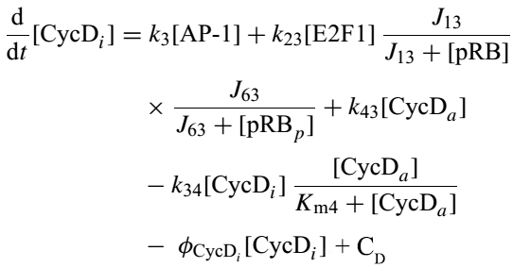
Extended from Prior Model
6
Notes:
List 9 important components
Run through the mechanisms
Authors cite past experimental studies that rigorously determined a range of molecules and processes in the network
Authors selected nine of these components they “believed” to be the most important in controlling the G1-S transition

Slide 7
Assumption and Limitation of the Method
No validation research to support the balance between a constitutive synthesis rate and the E2F1 dependent synthesis rate
No quantitative experimental data provided for validation of the bistability
Number mechanisms are conflict with the mechanisms used in other paper
pRB was shown to positively autoregulated by itself in Park’s research

Slide 8
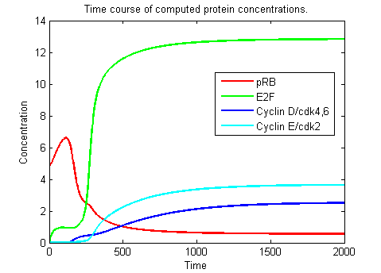
Results: Bistability
Simulation results obtained generated the bistability phenomena
reasonably describe cell proliferation

Slide 9
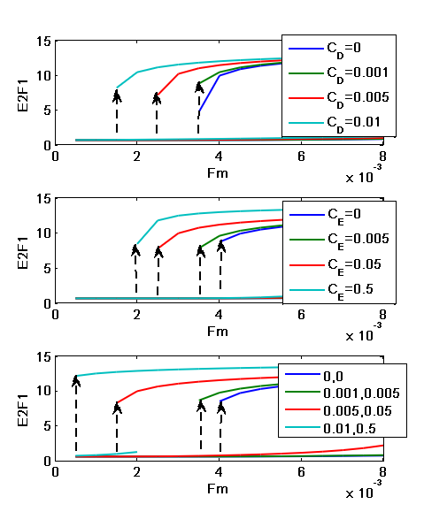
Results: Overexpression in the cyclin D and Cyclin E Changed the SN
Simulation results obtained reasonably describe cell proliferation.
Oscillations
Reasonable distribution of cell cycle phases in time
Time sequence and trajectory of the various components

Slide 10
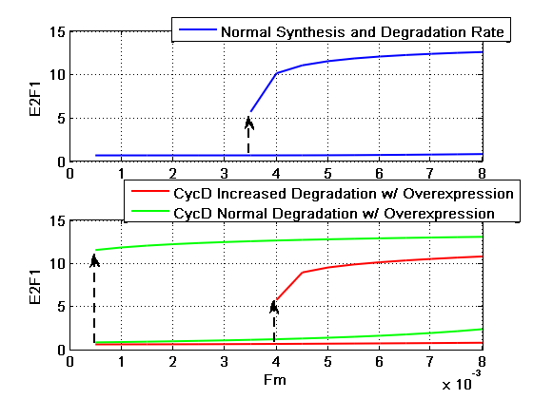
Results: Drug to Repress the generation of Cyclins
Responses of the cell cycle to different amounts of inhibitor below the threshold level
The oscillating concentration of free cyclin E and E2F, and doubling time are not sensitive
The level of the cyclin E-cdk2 active complex is the major change
10

Slide 11
Limitations of Study
The model is incomplete and simplified
Number of mechanisms and bimolecular interactions found in other paper is neglected
The model makes the assumption of double-inhibition double activation interactions between E2F1-pRB as a way to generate bistability
The parameter aren’t measured but rather are qualitative to have certain qualitative feature
There is no qualitative data validation

Slide 12
Path Forward
Study the significance of cdk2/cdk4,6 in the G1/S transition by adding inhibitors to the phosphorylation
Validate additional predictions of the model with additional experiments
Paper was published in 1999, and the cited paper is within 15 years before that time
Cdk inhibitors
After validation, the predictions from model can be used to suggest new experiment designs
12

Slide 13
Citation
Thank you!
Questions?
13

